Slide 1
Cloud Computing Security

Slide 2
Topics
Why Cloud Security?
What is Cloud Computing Security?
Cloud Security Boundaries?
Public, Private or Hybrid?
Is Cloud Security is really a concern?
Brokered Cloud Storage?
Cloud Security Mechanisms for Protecting Data?

Slide 3

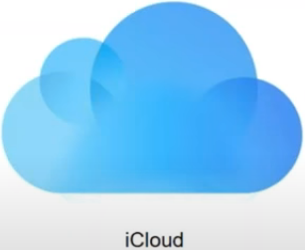

Why Cloud Security?
Lets talk about some security breaches in the past:
In 2012, 6.5 M usernames and passwords were hacked from LinkedIn database and published to public sites
Sony experienced the most aggressive cyber attack in history where in their financials, movie projects and much more was published publically by hackers.
iCloud faced a similar hack wherein private images of users from their database were made public

Slide 4
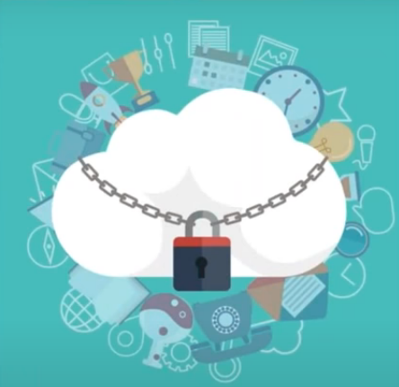
What is Cloud Computing Security?
It is the use of latest technologies and security techniques to protect your data, applications and infrastructure associated with cloud computing
Data in Cloud should be stored in encrypted form.
Notes:
Notes:
Establish bi-directional communication with millions of IoT devices.
A thing – does something useful.
A sensor – computes and communicates attached to the thing.
A gateway – collects data from the thing.
Cloud computing – analyzes data from sensor and providing feedback to the thing.
References:
Image source: https://1.bp.blogspot.com/-OpDDrfKKBV4/VrK5cPNS0RI/AAAAAAAALBk/1nEQTIRThY4/s1600/AzureIoTOnGA.PNG

Slide 5
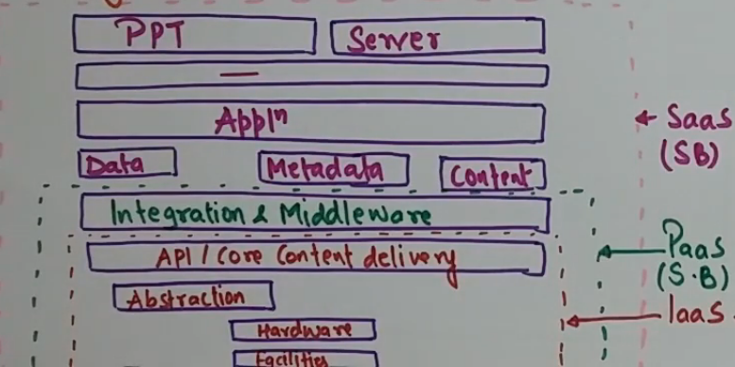
Cloud Security Boundaries
Notes:
Things have to be useful and secure, authenticated and authorized.
They also have to be very low power.

Slide 6
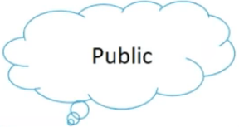
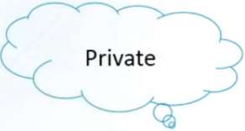
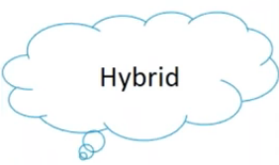

Public, Private or Hybrid?
Notes:
Notes:
There are 3 subsystems in the Abstract layer of IoT. The 3 subsystems need to be connected to each other.
The distribution of each of these components depend on the application.
An application might have its own thinking & sensing subsystems.
Each subsystem:
must be complex and decoupled from each other, or tightly integrated into 1 service.
itself be a collection of distributed components
can interact with another subsystems without knowing the underlying details.

Slide 7
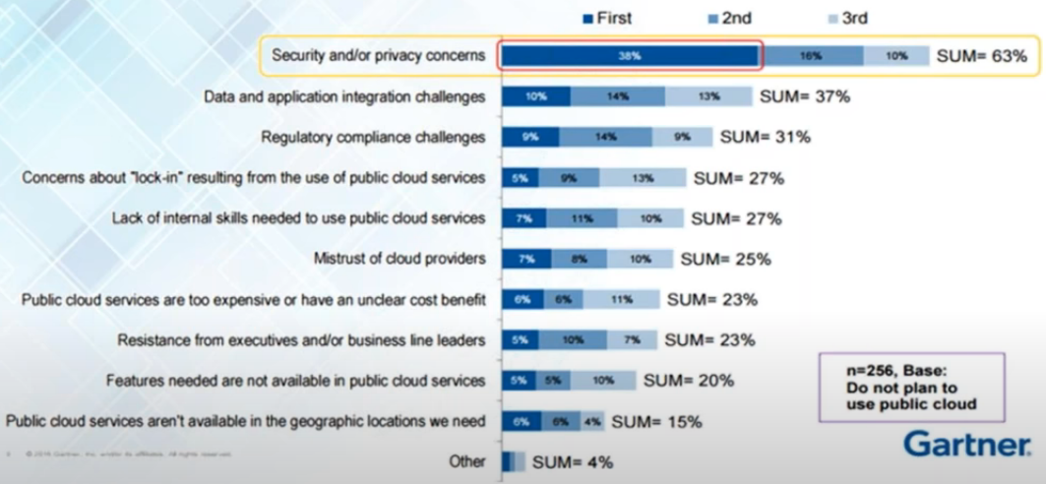
Is Cloud Security really a concern?
3 different approaches to acquire contextual information
Notes:
Notes:
Direct sensor access
Used in devices with sensors locally built in.
The client software gathers the desired information directly from these Sensors.
It is not suited for distributed systems.
Middleware infrastructure
Introduces a layered architecture with the intention of hiding low-level sensing details.
Context server
Distributed approach extends the middleware based architecture by introducing an access managing remote component.
Gathering sensor data is moved to the context server to facilitate concurrent multiple access.

Slide 8
Cloud Security Concerns
Third party handling data (accessing and managing data)
Cyber attacks (top challenging issues)
Insiders threats
Govt. Intrusions (supervision of data)
Legal liability (court cases filed)
Lack of support (Competition)
Lack of standardizations (not follow same standards)
Responsible for the retrieval of raw context data

Slide 9
Cloud Security Threats
DoS (Denial of Service): Tries to bring services down
MIM (Man-in-the-Middle): Listen and alter communication
NS (Network Sniffing): Monitor all traffic
PS (Port Scanning): Scanning open ports and services
SIA (SQL Injection Attack): Steal information using queries
XSS (Cross Side Script): Embedding harmful scripts
Responsible for the retrieval of raw context data

Slide 10
Brokered Cloud Storage?
Used to isolate storage in cloud environments.
Broker with full access of storage (No access to clients)
Proxy (No access to storage but access to both clients and brokers)
Notes:
Notes:
The single information can be combined to high-level information, for more precious and accurate.
The problem of sensing conflicts might occur when using several data sources has to be solved in this layer.

Slide 11
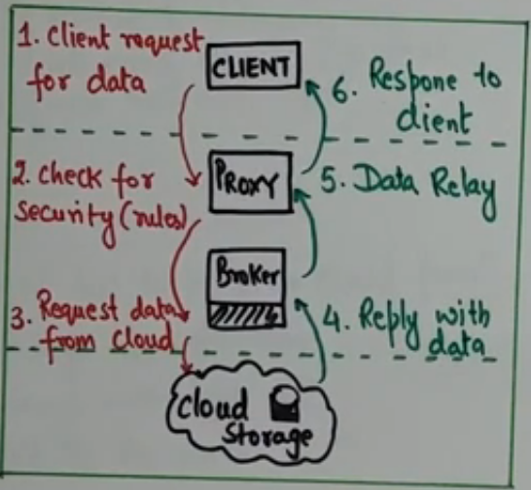
How Brokered Cloud Storage?
Notes:
Notes:
The single information can be combined to high-level information, for more precious and accurate.
The problem of sensing conflicts might occur when using several data sources has to be solved in this layer.

Slide 12
Cloud Security Mechanisms
Access Control
Auditing (Log management)
Authentication
Authorization
SSO (Single Sign-On)
PKI (Public Key Infrastructure)
Cryptography: Symmetric and Asymmetric Encryption Mechanisms
Responsible for the retrieval of raw context data

Slide 13
Cloud Security Mechanism – IAM
Identify and Access Management "IAM" encompasses the components and policies necessary to control and track user identities and access privileges for IT resources, environments and systems
Responsible for the retrieval of raw context data

Slide 14
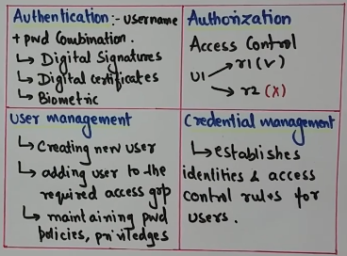
IAM Components

Slide 15
Cloud Security Mechanism: SSO
Single Sign-On (SSO): This mechanism enables one cloud service consumer to be authenticated by a security broker. A security context is established while consumer accesses other cloud services
Notes:
Notes:
The single information can be combined to high-level information, for more precious and accurate.
The problem of sensing conflicts might occur when using several data sources has to be solved in this layer.

Slide 16
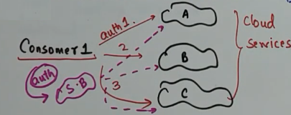
Cloud Security Mechanism: SSO

Slide 17
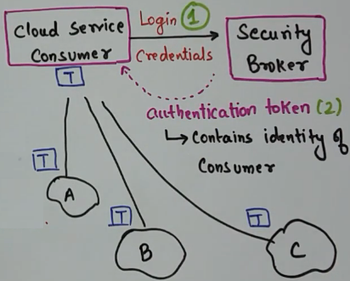
Cloud Security Mechanism: SSO

Slide 18
Cloud Security Mechanism: Symmetric and Asymmetric Encryption
Cryptographic Mechanisms
Symmetric and Asymmetric Encryption

Slide 19
Cloud Security Mechanism: PKI
Public Key Infrastructure (PKI)
Digital Certificates
Certificate Authorities
Digital Signatures

Slide 20
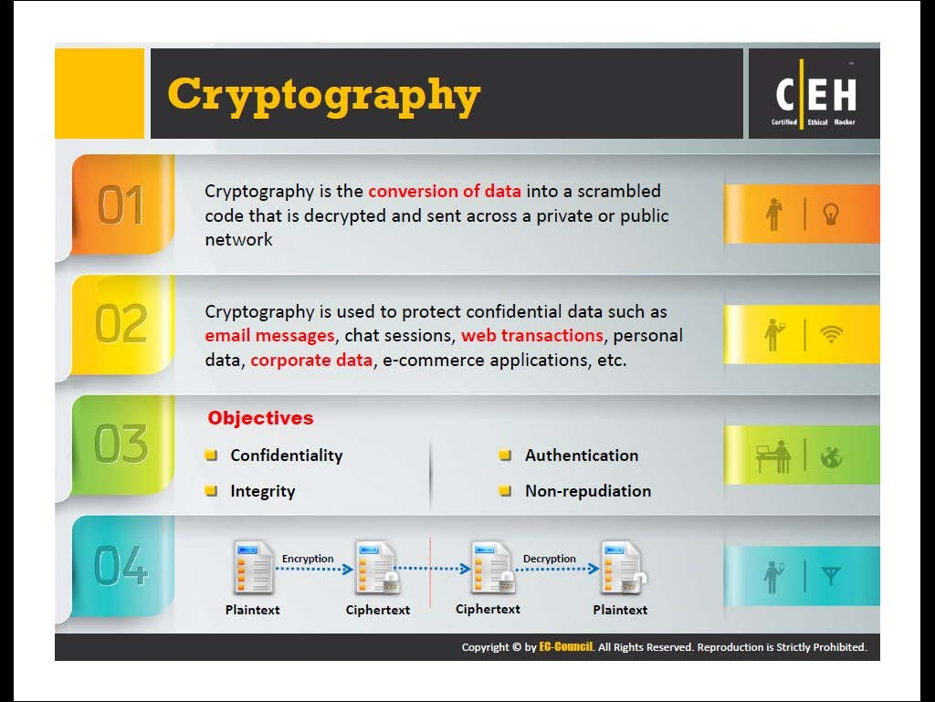
Cryptography?

Slide 21
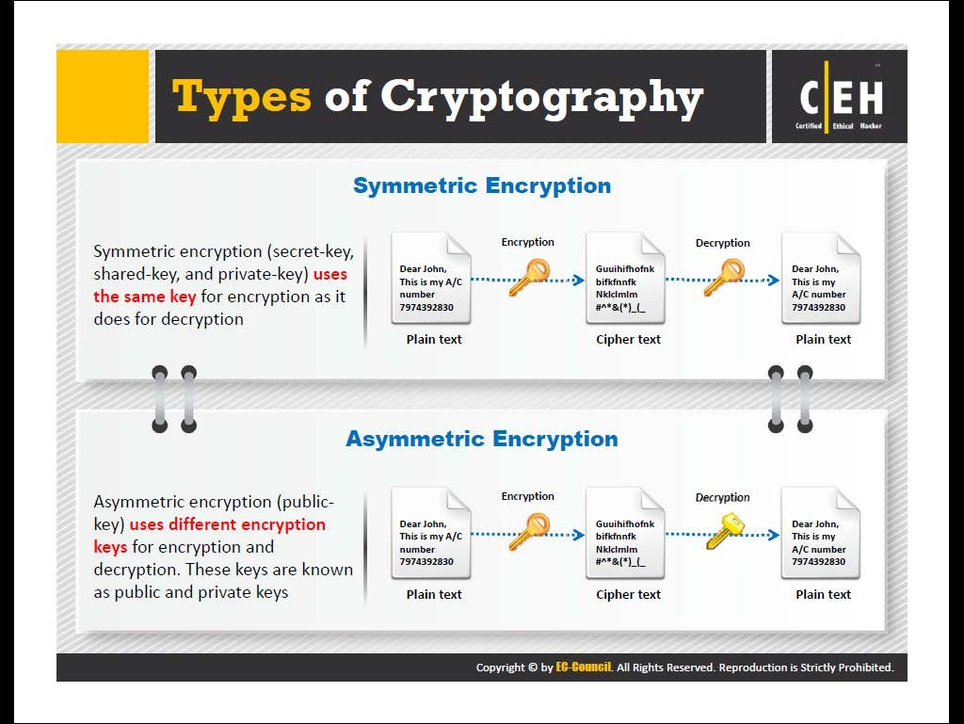
Types of Cryptography

Slide 22
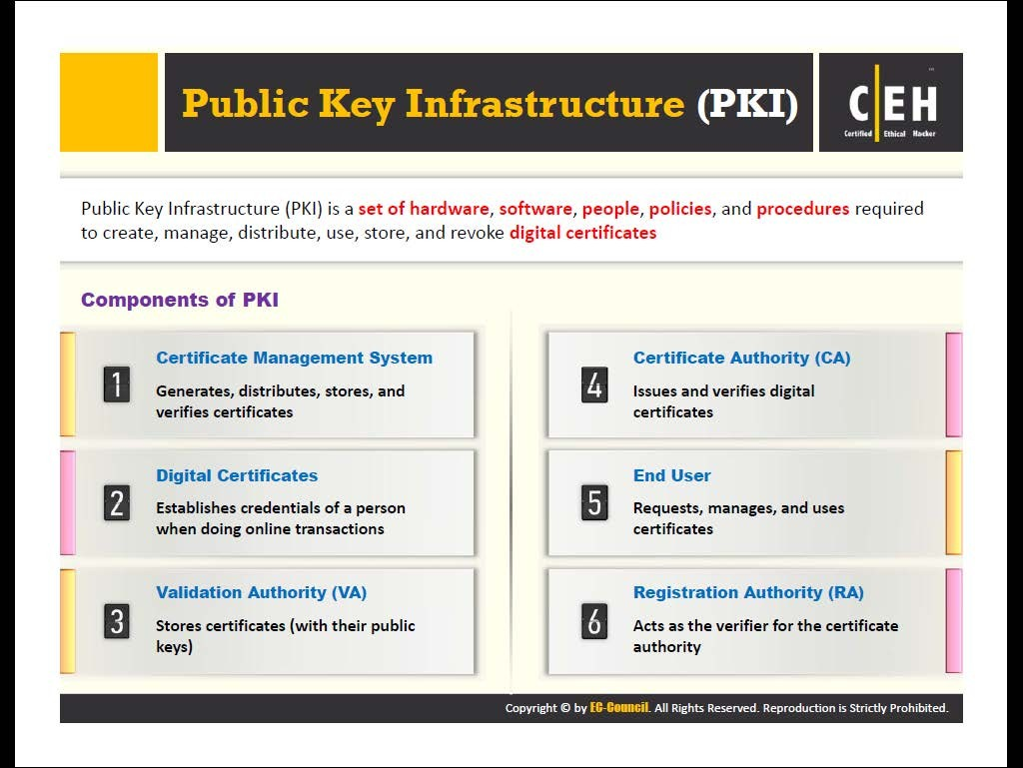
Public Key Infrastructure (PKI)

Slide 23
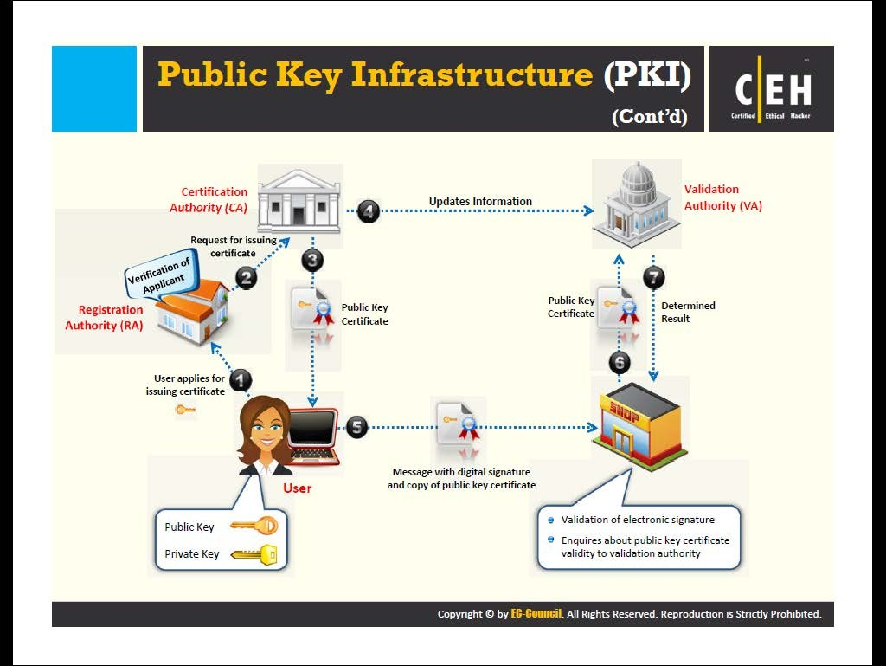
Public Key Infrastructure (PKI)

Slide 24
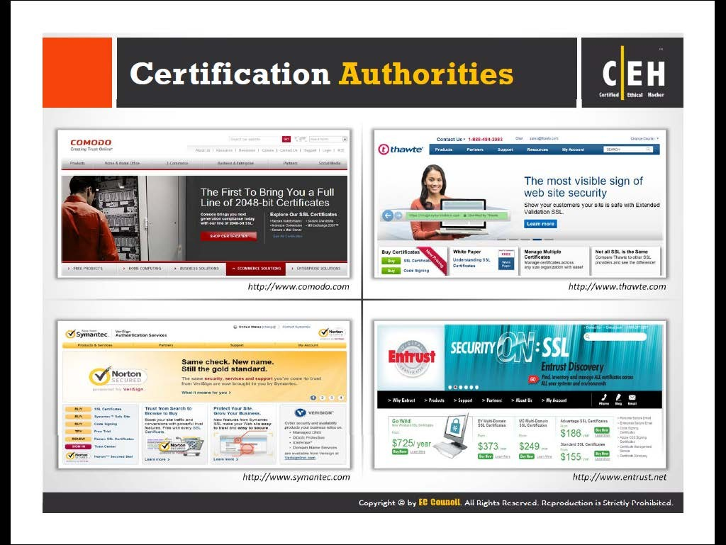
Certification Authorities

Slide 25
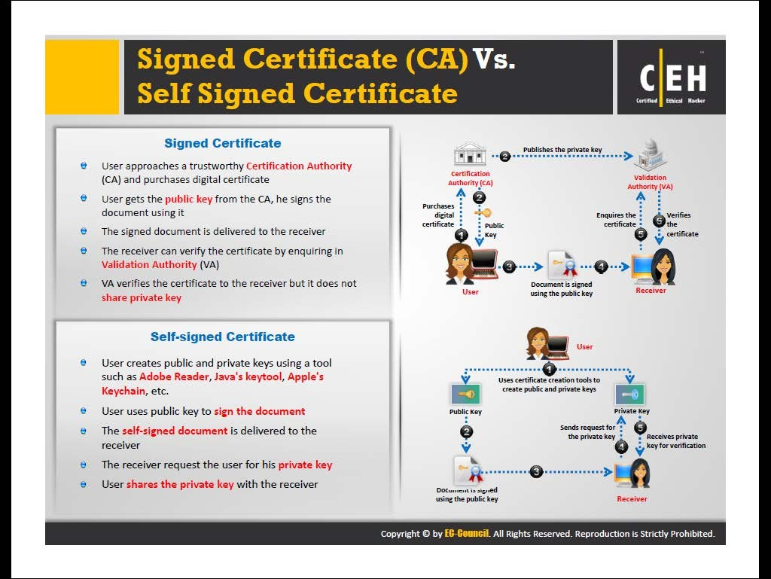
Signed Certificate (CA) vs Self-signed Certificate

